Slide 1
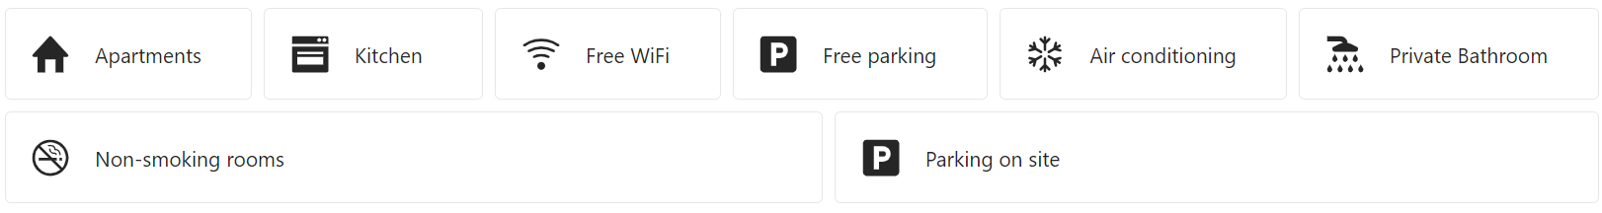

Slide 2
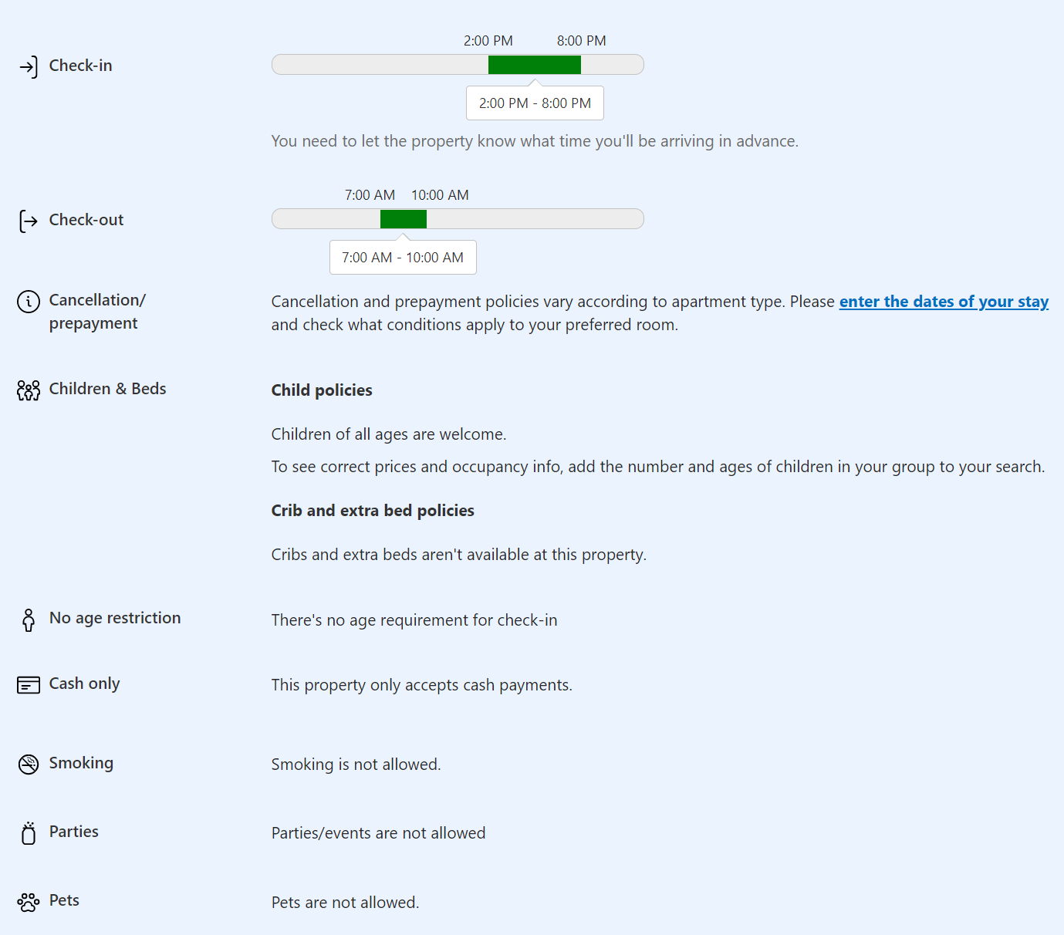
 | Cancellation and prepayment policies vary according to apartment type. Please enter the dates of your stay and check what conditions apply to your preferred room.
 | Child policies: Children of all ages are welcome. To see correct prices and occupancy info, add the number and ages of children in your group to your search. Crib and extra bed policies: Cribs and extra beds aren’t available at this property.
 | There’s no age requirement for check-in
 | This property only accepts cash payments.
 | Smoking is not allowed.
 | Parties/events are not allowed
 | Pets are not allowed.

